Slide 1
The forces of change

Slide 2
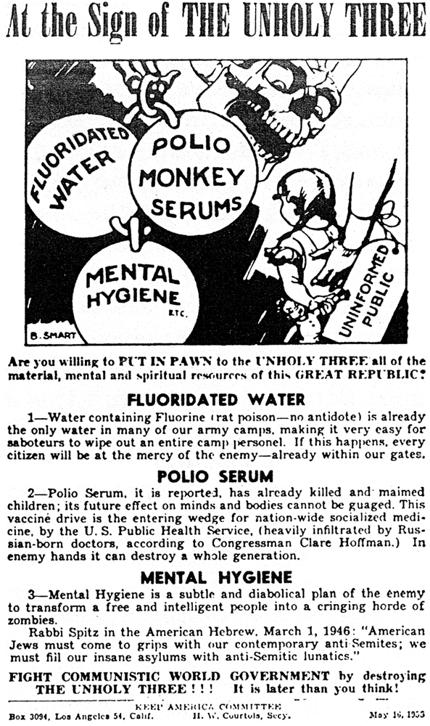
End of McCarthyism
1955…Peak McCarthyism Poster
McCarthyism branches out
To fear of all government
….anti fluoridation
…and vaccines
…anti mental health initiatives
Tyranny of conformism
…banning of books by communists
…civil rights…communists
…..socialists…enemies
…Eisenhower…reluctant to resist
( plus fear of Hoover)

Slide 3
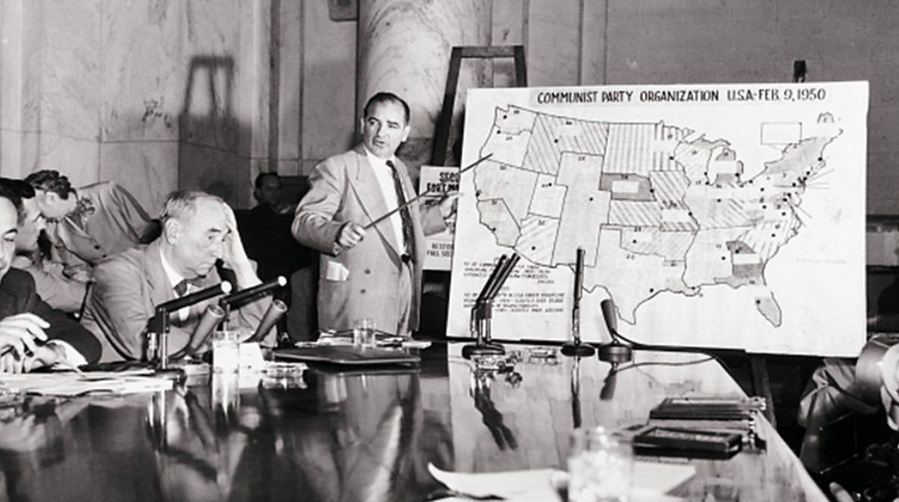
Army/ Navy McCarthy Hearings 1954/1955
McCarthy at Army Hearings
McCarthy and Cohn attack Army/Navy
…list of 205 subversives
…challenged to produce evidence “before
Sun goes down”…unable to do so
Televised,,,36 hours watched by 80 m
Mistake…McCarthy claims army rejects
Promotion Of one of Cohn’s ‘friends
Army proves forged letters, photographs
Public opinion of McCarthy crashes (from
60% approval to 19%...TV documentary
Shows abuses
Senate “Censures” McCarthy…hearings
Collapse….ridicule. Dies alone 1957

Slide 4
Impact of end of McCarthyism
Return to more rational discussion in Senate/ politics
Politics of extremism out
“Conservatism” rebranded
Use of media to highlight social issues
Civil Rights Organisations freed from “Communist Label”
Hoover/ FBI will continue to harass
NAACP (National Association for Advancement of Coloured People) empowered

Slide 5
Warren Supreme Court
About Supreme Court
Equal Branch of Government/ decide on constitutional “fit” of laws
9 Justices appointed for life by President/ approved by Senate
Historically Conservative
“Dred Scott”1857….support slavery/ Plessey Ferguson 1897 …justify segregation “separate but equal”
Opposed to New Deal….threats by FDR
Warren Court (1953-1969)
All Supreme Court appointed during 1932-1945 FDR Presidency
Split during 1940’s …intervene / not intervene in civil rights cases
1953 Justice Warren appointed by Eisenhower: remedial responsibility of the law
Civil Right cases vs segregation will drive change

Slide 6
Civil Rights and the Cold War
Eisenhower…Supreme Court Warren world tour…..confronted in Nehru……….you propose freedom. You do not practice it.
Eisenhower "Our American system like all others is on trial both at home and abroad, ... the extent to which we maintain the spirit of our constitution with its Bill of Rights, will in the long run do more to make it both secure and the object of adulation than the number of hydrogen bombs we stockpile.“

Slide 7
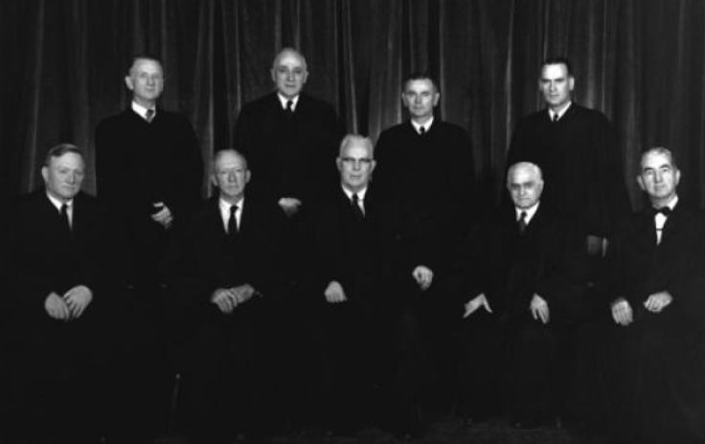
Warren Court 1953-1969 …….Nine White Men (this will change too)

Slide 8
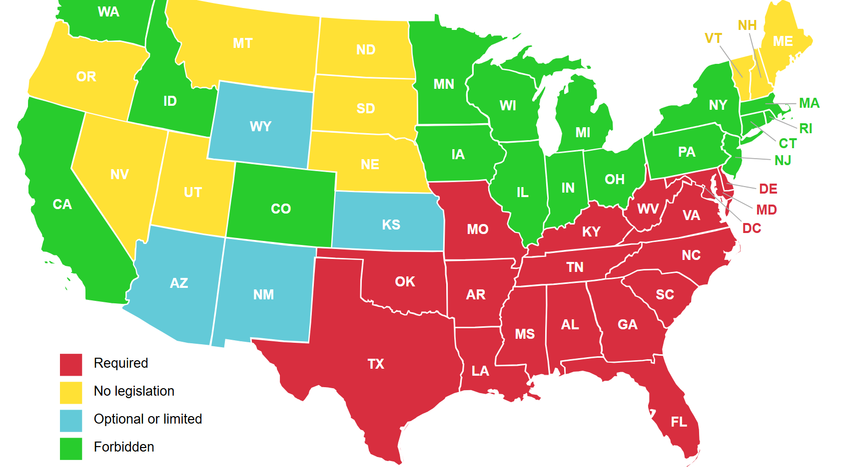
School Segregation prior to Brown
Segregation enforced
By law South
….Jim Crow laws
“Zoning” restrictions
create “informal”
.segregation in North
And West”

Slide 9
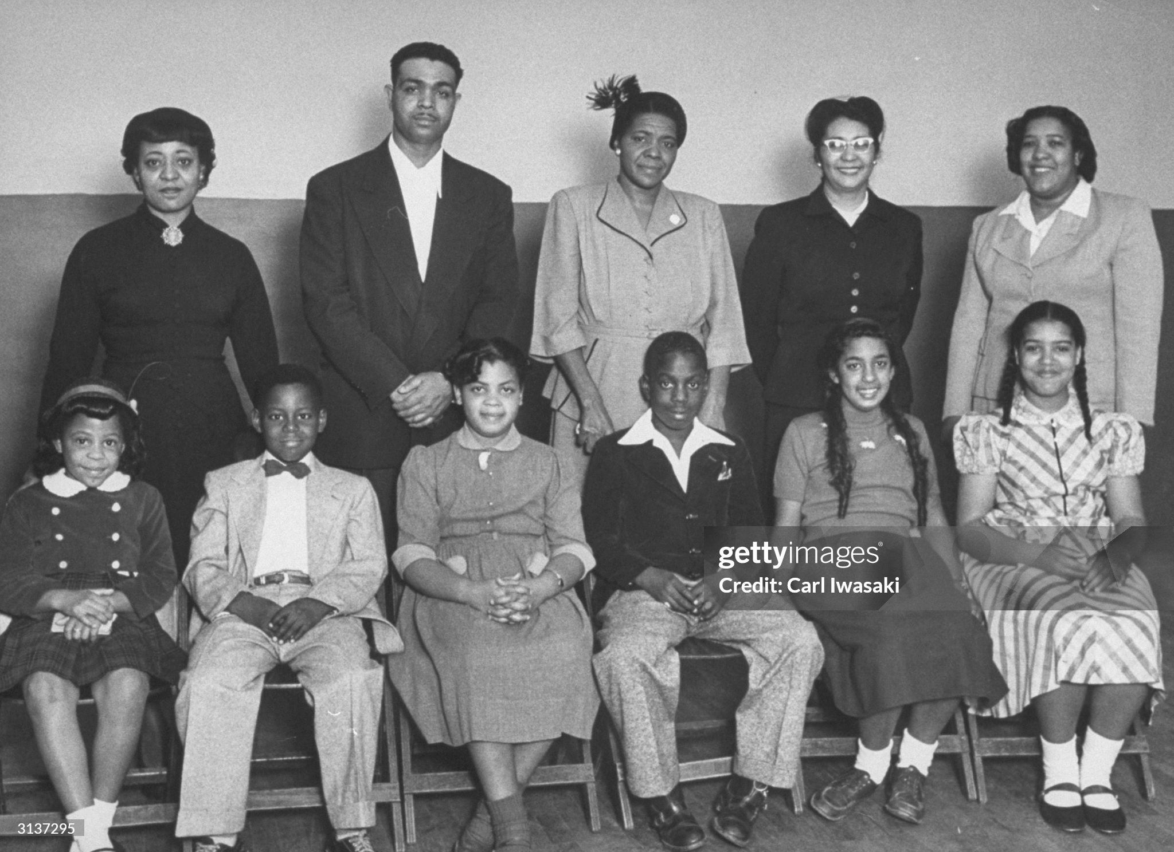
Brown vs Board of Education Case 1954
The Plaintiffs
1951…Oliver Brown (welder)
Kansas…want daughter Linda to attend
“white” school 4 blocks from house…avoid 5 miles to “black school”
..Linda refused entry
Joins other .suite vs School
….support NAACP
…rejected by District Court
…appeal to Supreme Court
Court rules 9-0 “separate not equal”
….desegregation ordered “with all
Deliberate speed” ….but no means to
enforce
Applicable across USA…but resisted
Across South by violence, court fights, local
politicians

Slide 10
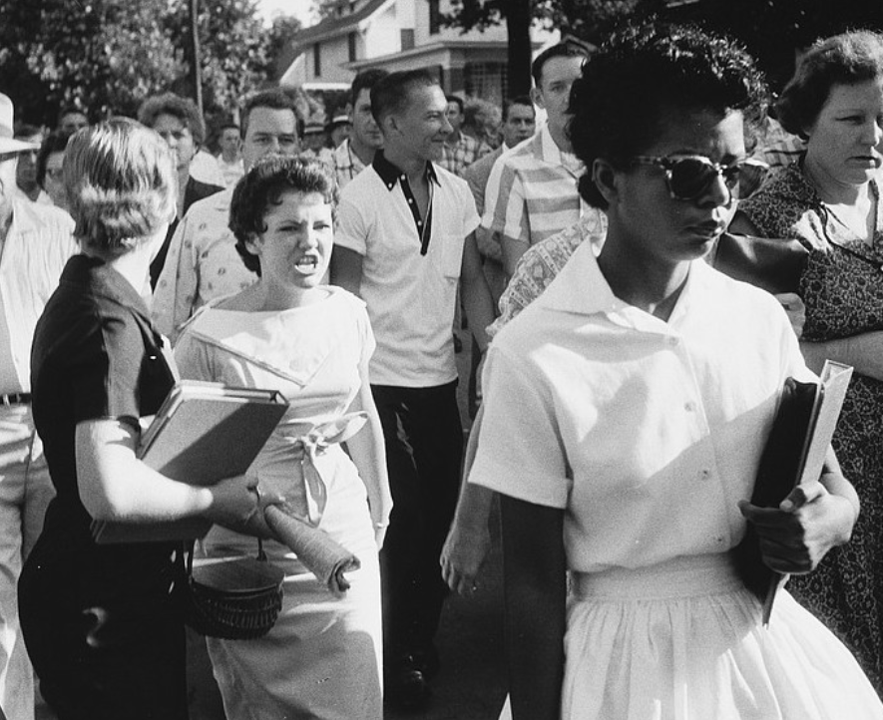
Little Rock Arkansas 1957
Brown ruling ignored
By state of Arkansas
..compelled to comply
Governor adopts
Minimal plan
….hires mob to block entry
Students attempt to
enrol
State Government
Uses National Guard
To prevent enrolment
…claims “unsafe”

Slide 11
“massive resistance” across State

Slide 12
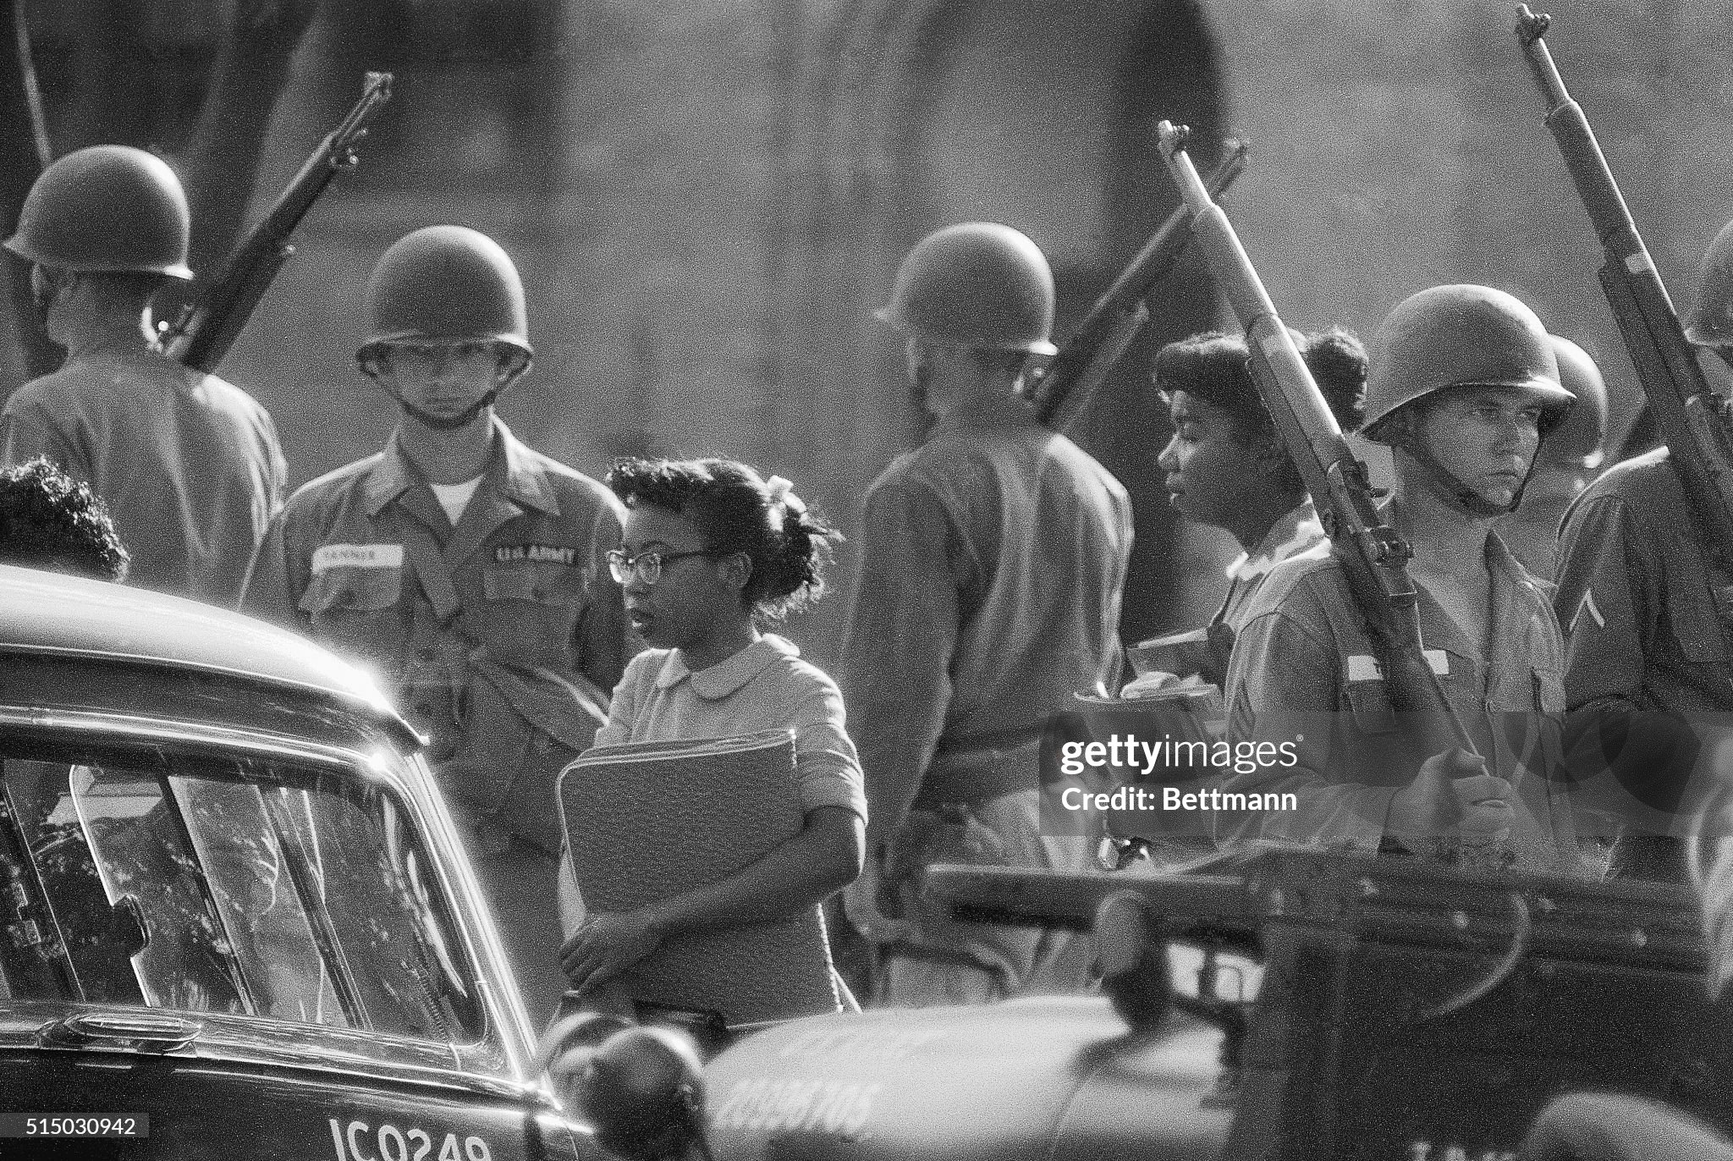
Eisenhower response: bring in the army to enforce law

Slide 13
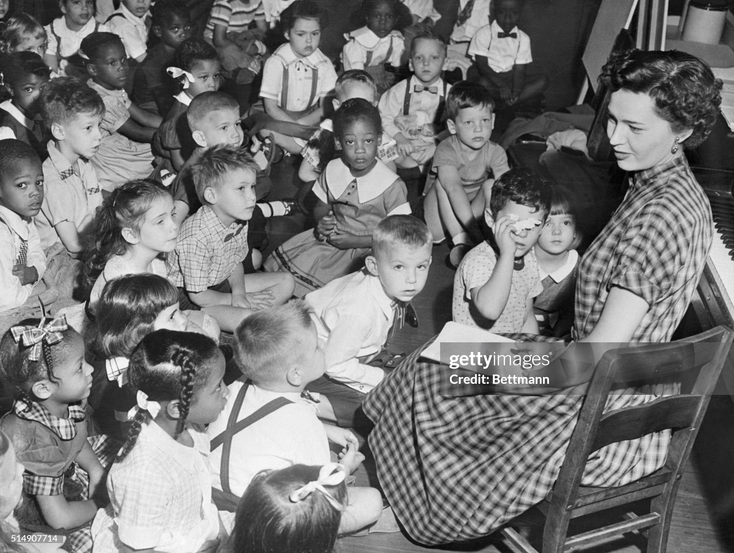
Integrated class rooms 1956 …
Integration school by school basis
….fought by courts
…state and local politicians
….violence
Consequences
….children bullied, segregated
….black schools closed
….private “white only” schools
….black teachers fired (40,000)

Slide 14
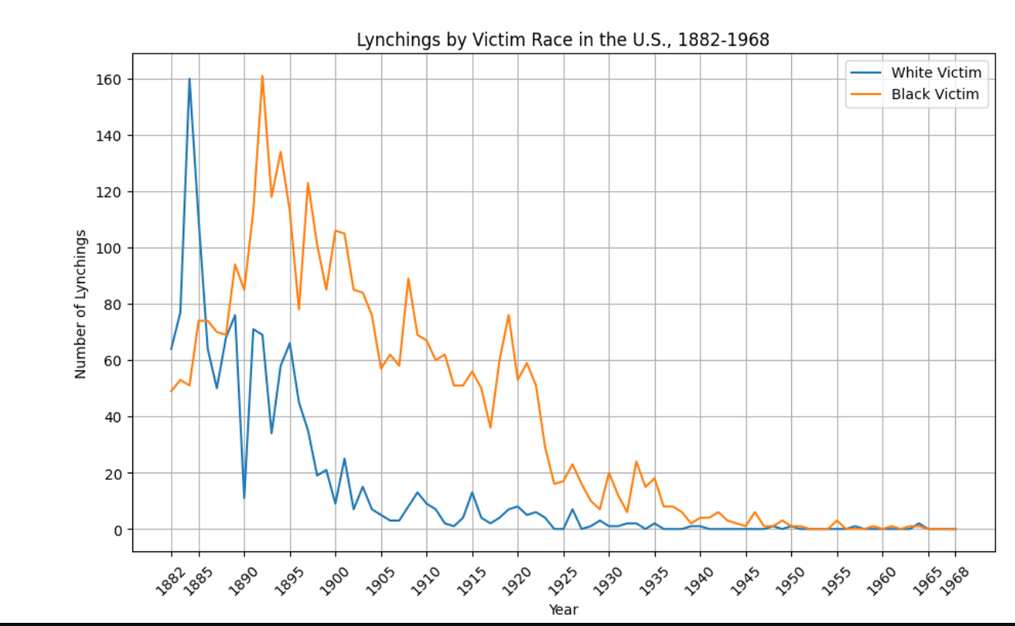
Reduction in racial violence. …..lynching reduced to 2-3 per year by 1950s ….education/ reduction KKK/ black migration north/public awareness

Slide 15
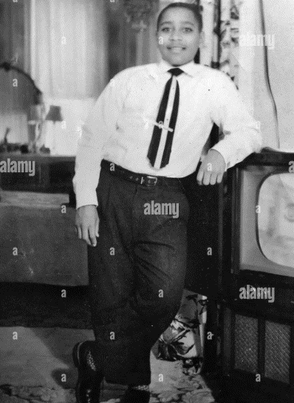
Emmet Teal Trial “lynching” 1955
Born Chicago 1941..parents moved
From Mississippi
Father executed for rape & murder
Italian women Italy 1943
Mother brings up Emmett. Sends to
Mississippi to stay with relatives
Incident at meat market
…touches sales clerk
….whistles at white woman
….accosts her(?)
Kidnapped, shot, dumped in river
…witnesses
…2 white males arrested
…50,000 attend funeral

Slide 16
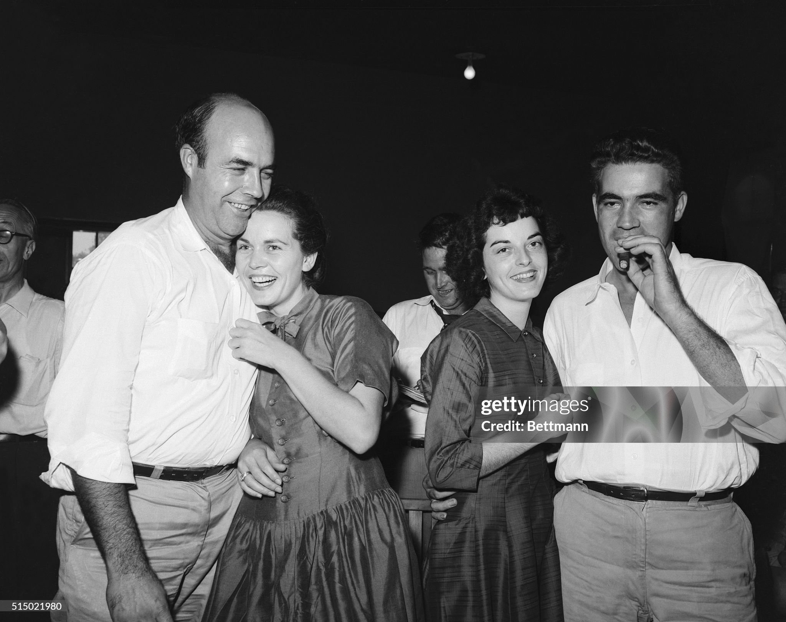
J Milam, Colin Bryan, Carol Bryant
Highly publicity for trial
NAACP…”Mississippi murdering
Children…
Eisenhower demands justice
…Mississippi defiant…
…global media present
…All white jury (no blacks allowed)
Defendants acquitted
..jury wait one hour
...sell story to Life magazine
…”hell yes..we did it ..teach
A lesson on manners
Triggers resistance across South
…Rosa Parks..bus passenger

Slide 17
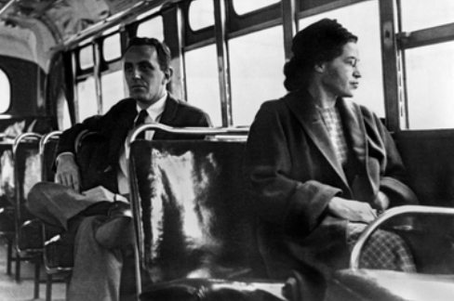
Montgomery Bus Strike 1955
Rosa Park….back on the bus
Bus service segregated
Aurial Gayle harassed by
Conductor…sues Mayor
Browder
Rosa Parks ….refuses to move …arrested & fined
NAACP organise boycott with local church…pastor Martin Luther King
….appeal to Supreme Court
Browder vs Gayle.
……Segregation Illegal
….enforce at state/local level
…..fight for equality continues into
1960’s

Slide 18
Civil Rights Act 1957
Pushed by Eisenhower due to Little Rock Resistance
Intent to abolish voting suppression by Lyndon Johnson majority leader
Jury Right Amendment…..breaches of law to be subject to “all white jury”
World’s longest filibuster 24 hours reading of statute book
Law passed but ineffective…but first attempt to change south since Reconstruction
Political realignment
Northern blacks/ Southern Whites incompatible
John F Kennedy/ Lyndon Johnson rise to prominence
Republicans align business/ Southern whites
Real change will not happen till 1960’s

Slide 19
USA late 1950’s
USA Increasingly unsettled….Institutions under quest
Civil Rights Issues percolating….disrupting established ways getting challenged
Ongoing Cold War issues….but seemingly far away and no threat since USA all powerful
Then something new, strange, threatening

Slide 20
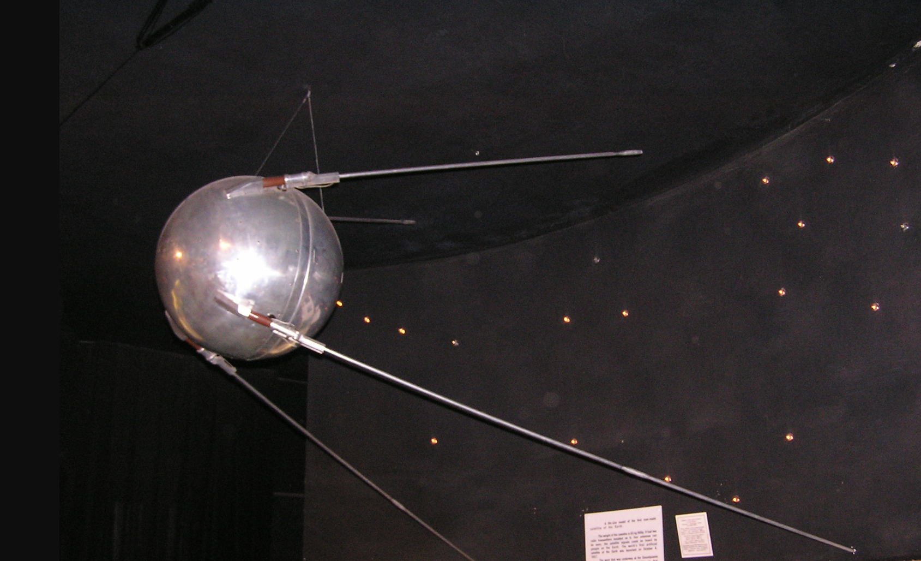
Sputnik 1957

Slide 21
The Cold War suddenly a threat to everyday life ….to dominate US life and politics ….subject of Talk 35

